Slide 1
Accelerate the delivery Reduce your dependencies
Rodrigo Moreirao – Gerard van der Pol
Developer Experience Days - April 25/26th

Slide 2
Feature Flags
Developer Experience Days

Slide 3
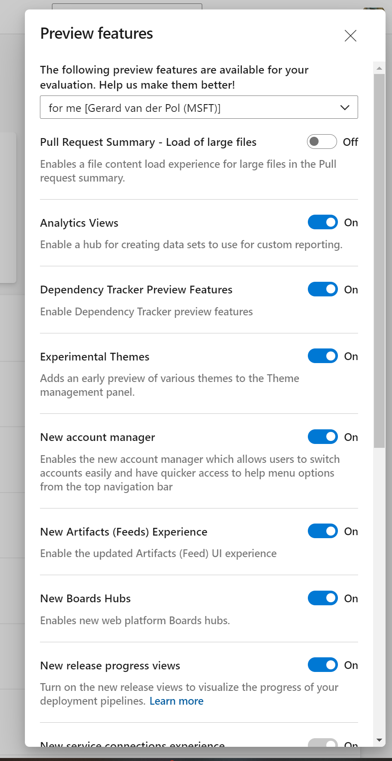
Feature Flags
All code is deployed, but feature flags control exposure
Reduces integration debt
Flags provide runtime control down to individual user
Users can be added or removed with no redeployment
Mechanism for progressive experimentation & refinement
Enables dark launch
Notes:
Demo: 12-14 minutes

Slide 4
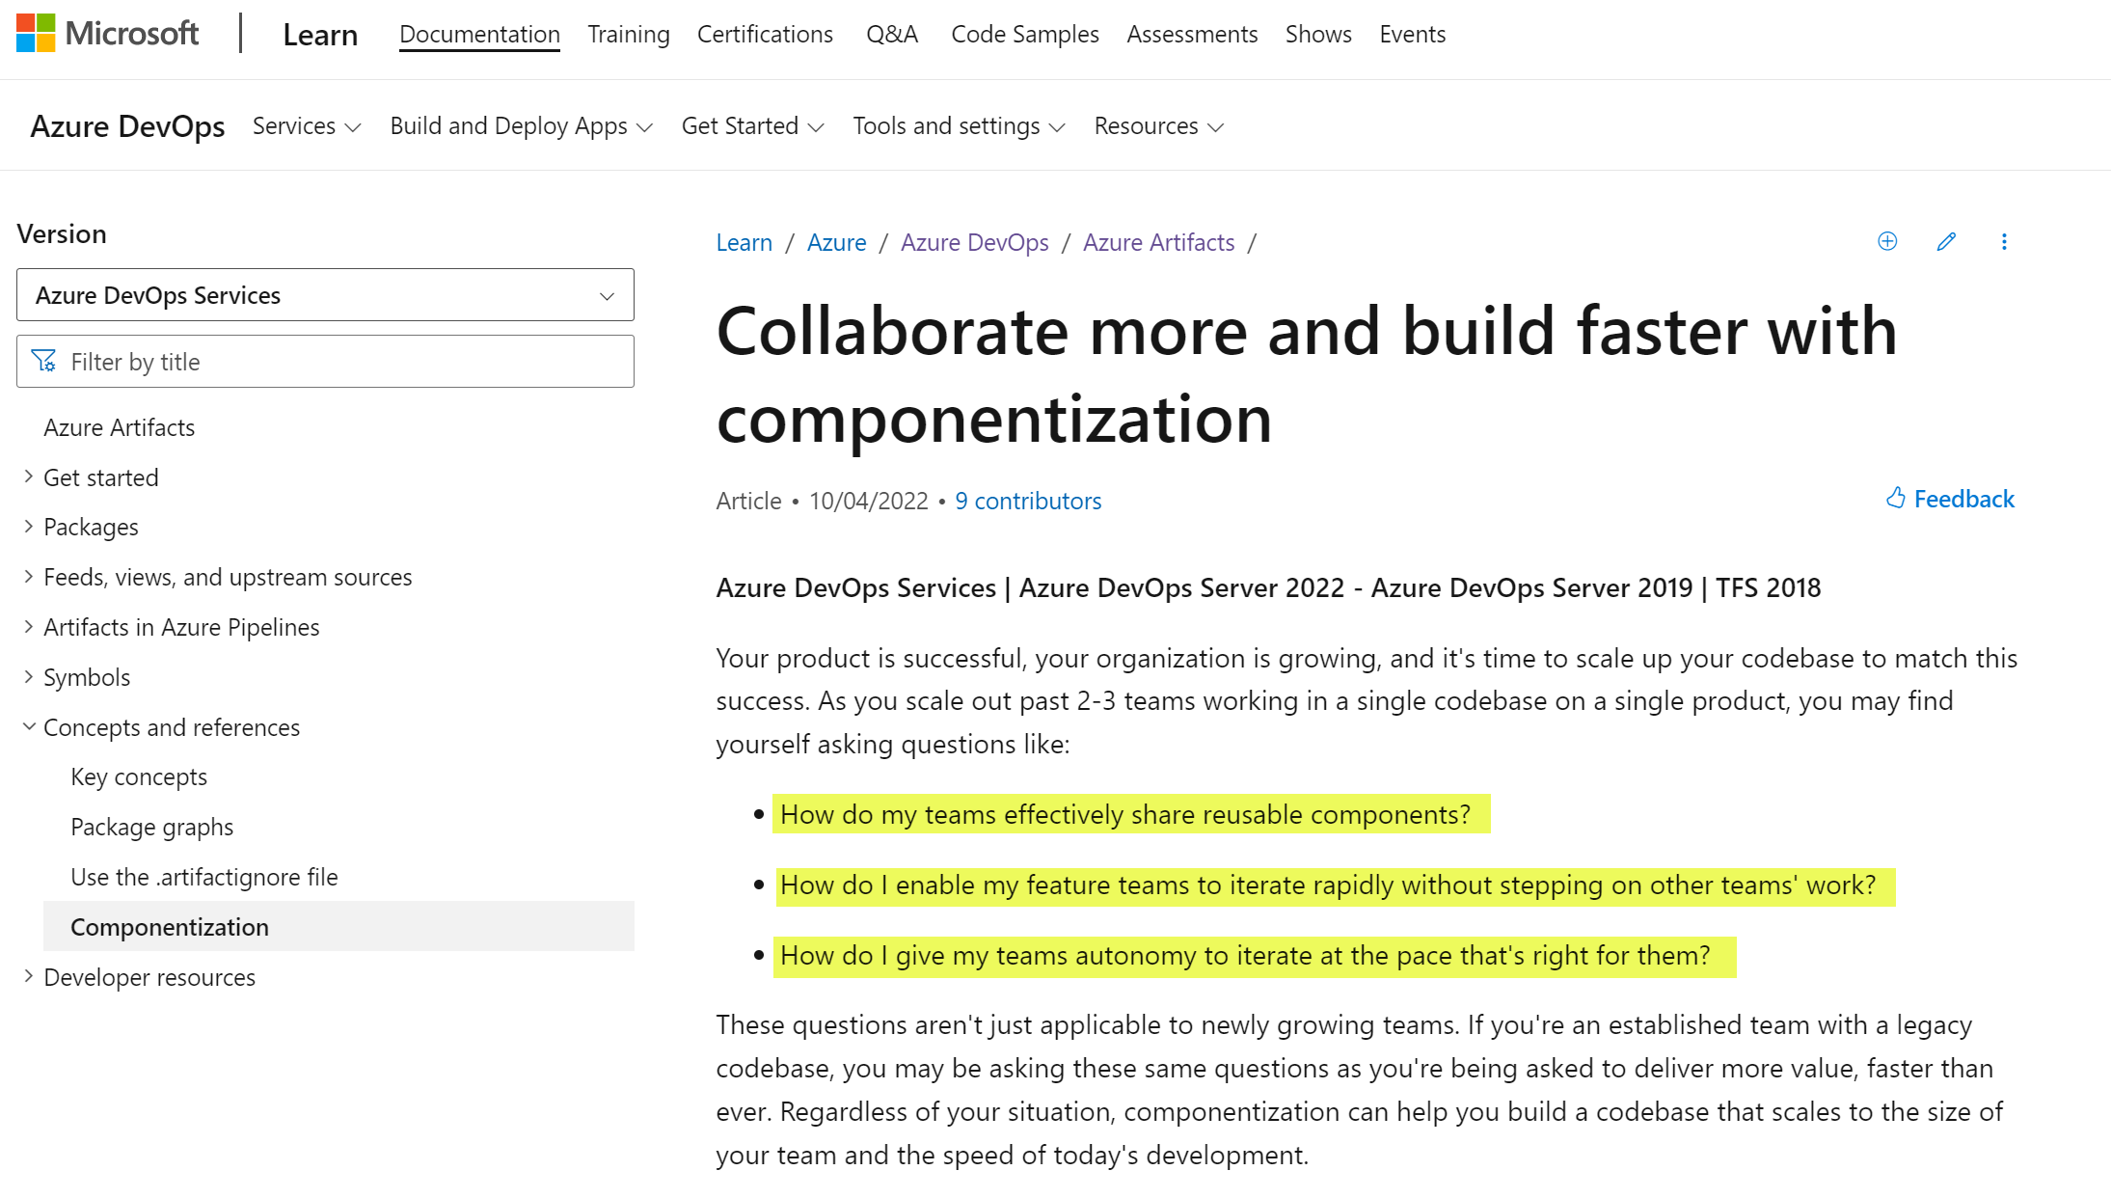

Slide 5
Dealing with cross team dependencies
Developer Experience Days

Slide 6
Cross team dependencies
One Product team
Web Frontend Feature Team
API Feature Team
Backend Feature Team
Consuming V1
V1
Prod
V1

Slide 7
Cross team dependencies
One Product team
Feature Team
Consuming V1
V1
Prod
V1

Slide 8
Reducing dependencies
Product team A
Product team B
Feature Team
Consuming V1
V1
Prod
V1

Slide 9

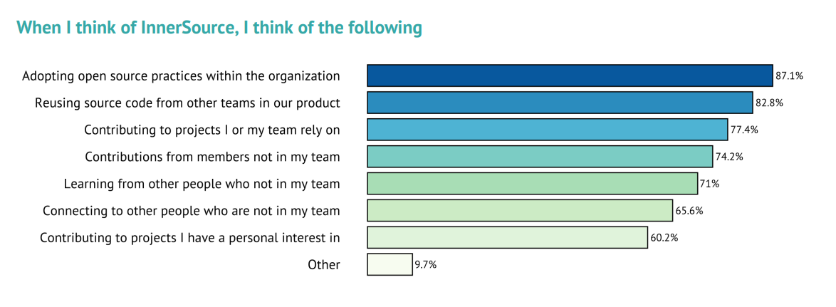
“We have seen a huge increase in the adoption of Inner Source in the past two years, as more and more organizations recognize the potential for Inner Source to break down silos, enable code re-use and accelerate innovation.”

Slide 10
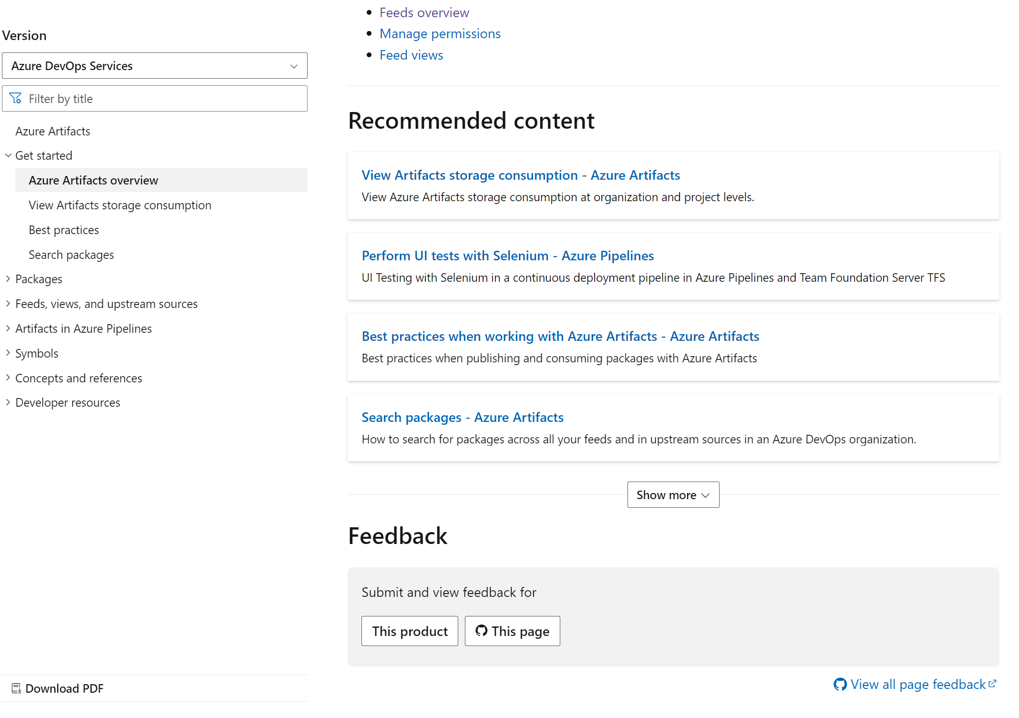

Slide 11
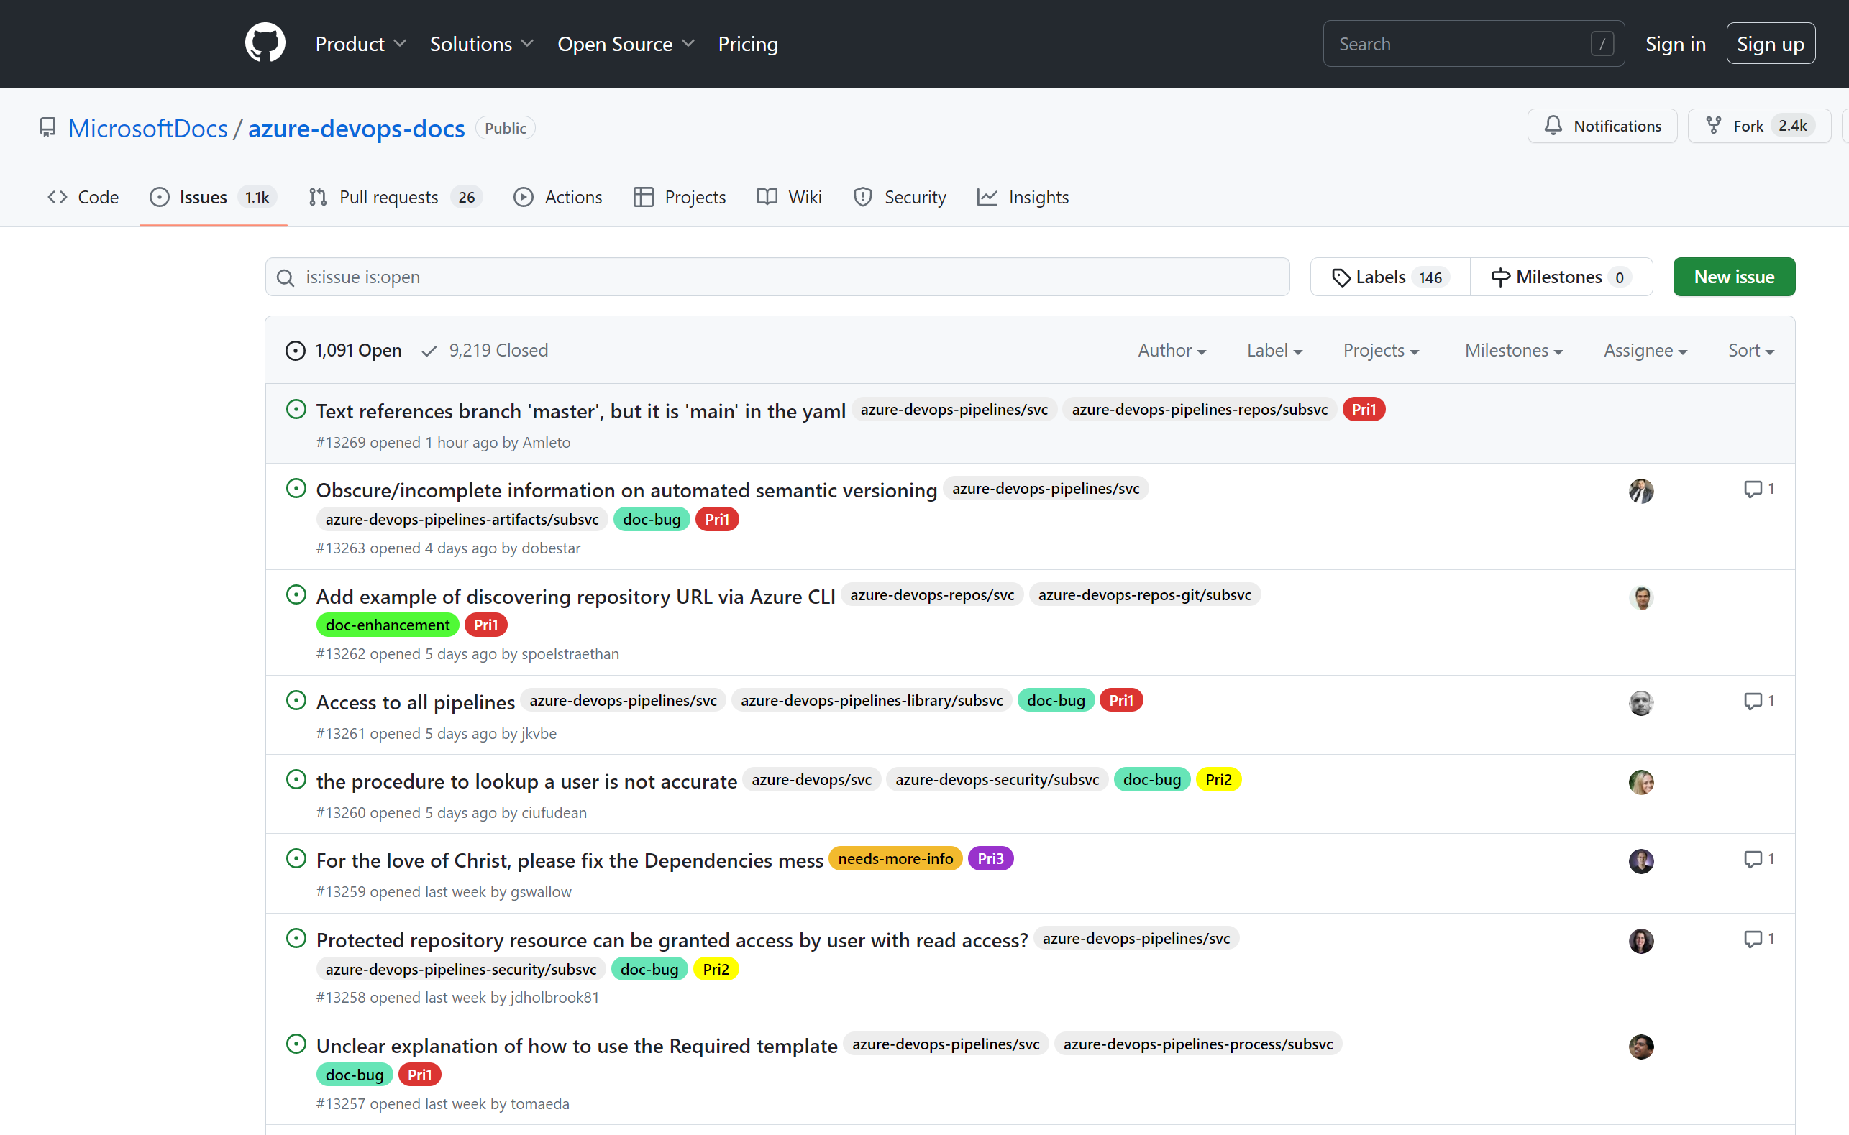

Slide 12
What’s needed to adopt Open Source practices
Unified Repo - Full visibility into all software assets, in particular all source code, is important
Be able to find Inner Source initiatives in organization
Reusability requires modularization in the software architecture
Enable engineering to contribute - timeline pressure and commitments on feature content does not allow for developers to spend the time needed to develop shareable code and provide support
Mindset - Owners reluctant to receive contributions due to the required maintenance that comes with them

Slide 13
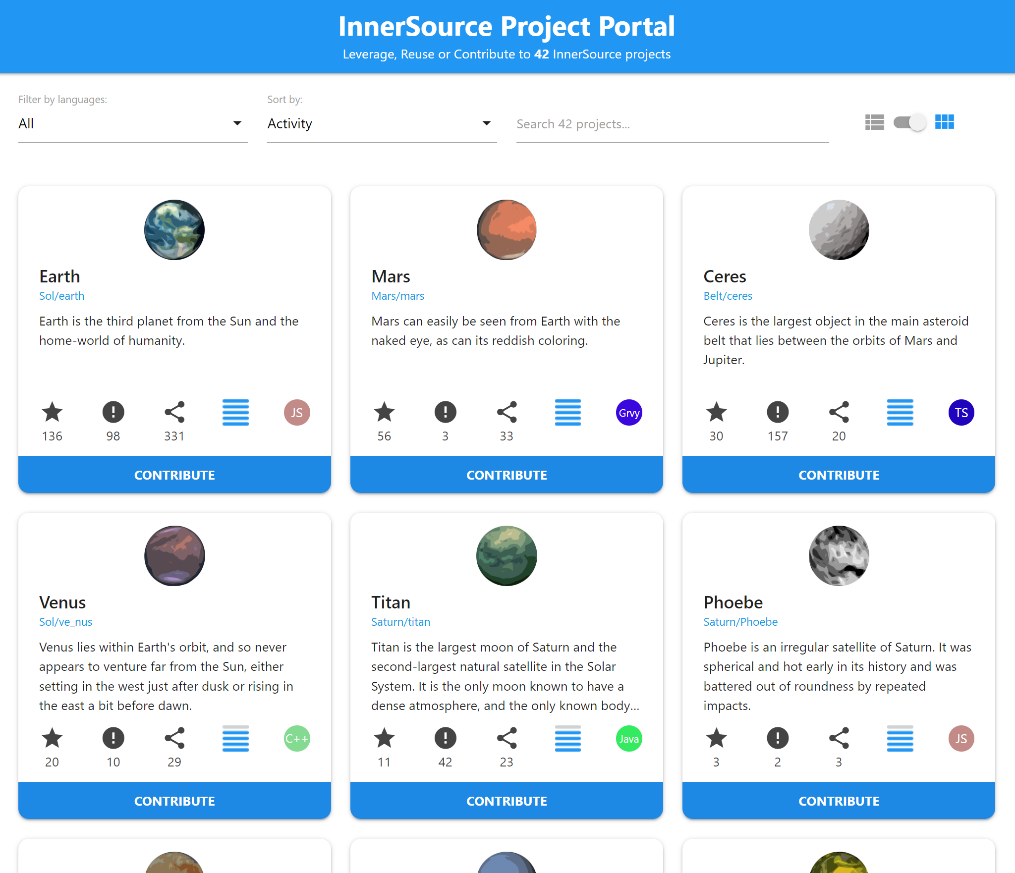

Slide 14
Benefits of Inner Source
Efficiency – cost & time reduction - Inner Source empowers teams to contribute changes themselves instead of escalating or building own workarounds
Quality of code & product - all can contribute and help detect and resolve bugs or bring in fresh and innovative ideas
Knowledge sharing & networking – Inner Source can lead to contribution across team and business unit boundaries that might not have happened otherwise

